Slide 1
Vegetable Management System
By S GANESH RAM

Slide 2
Objectives
In this project, we aim to provide an application for vendors to sell their vegetables to the consumer.
The vendors can add or remove the products
The customers choose between vendors for ordering

Slide 3
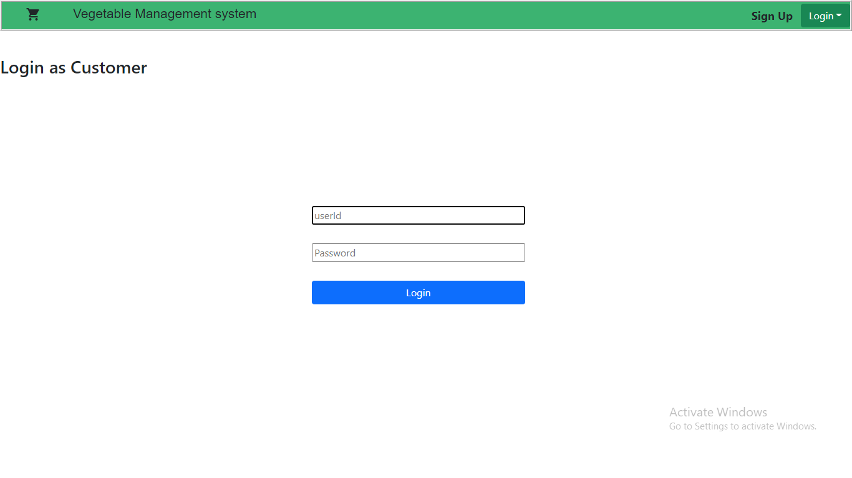
Front Page - Login as Customer or a Vendor

Slide 4
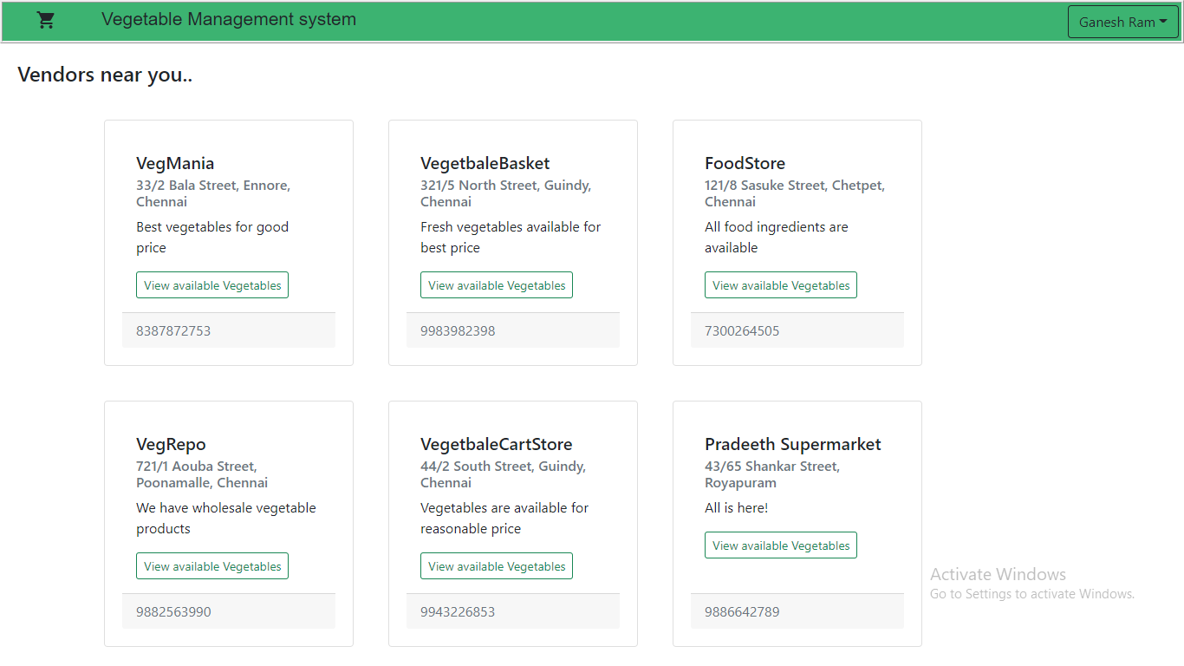
Customer Dashboard where we can choose Vendors

Slide 5
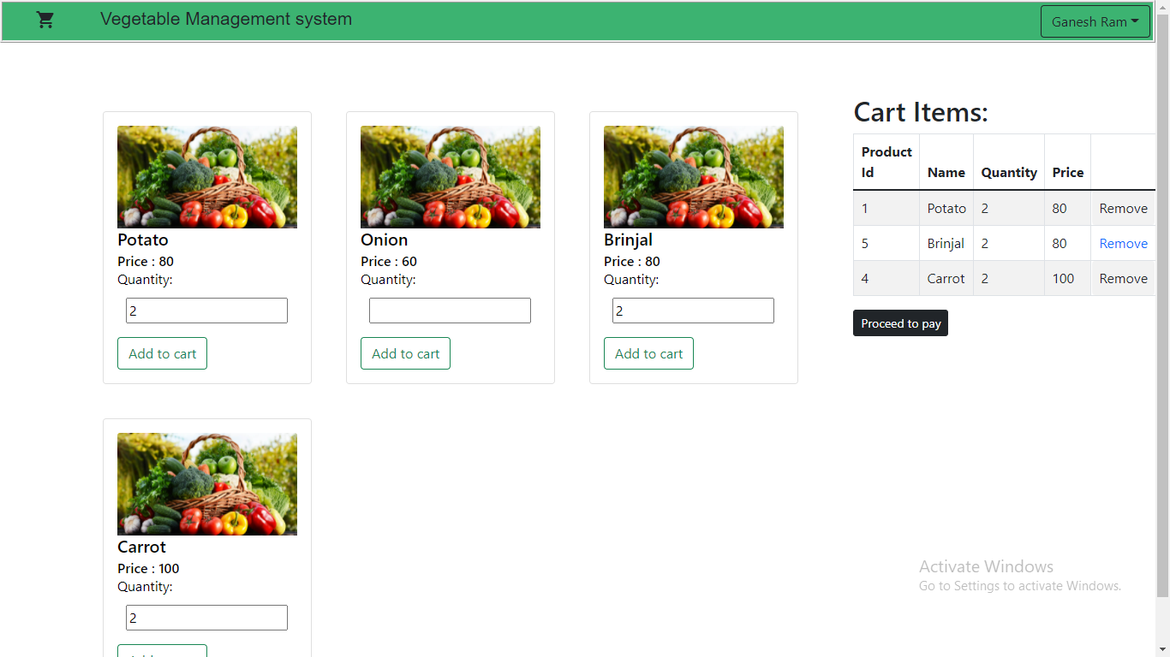
We add available vegetables to cart from the vendor

Slide 6
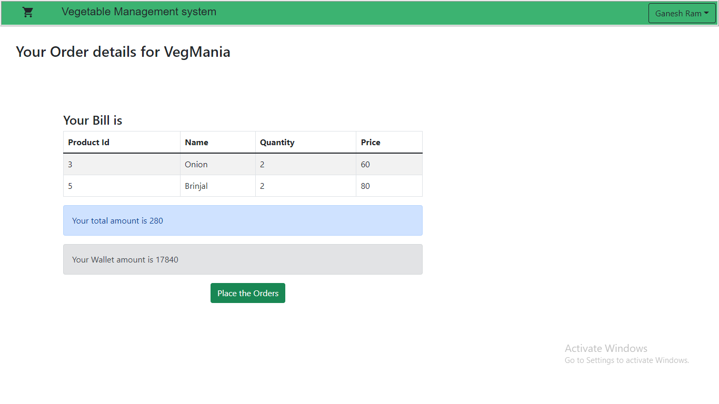
Finally we can place the order and the order awaits approval from vendor

Slide 7
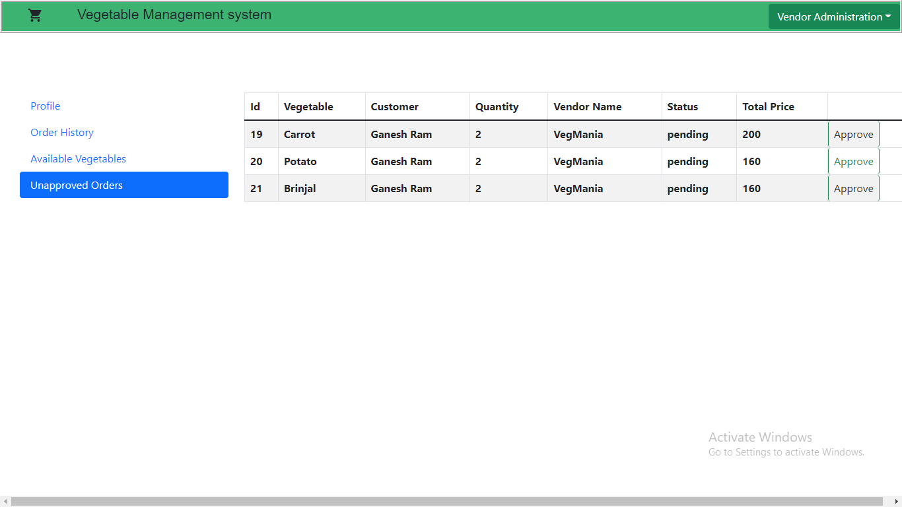
Vendor would approve or not

Slide 8
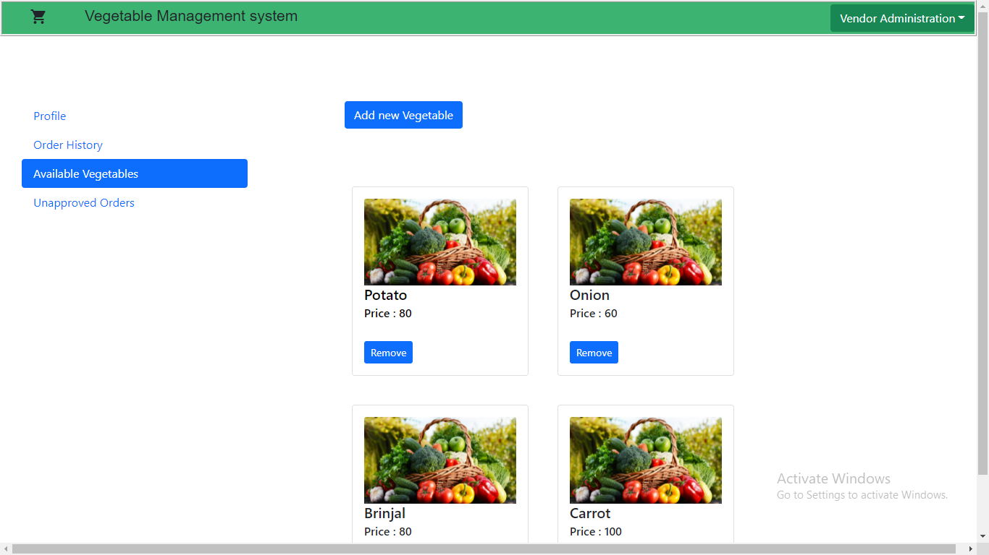
Vendor can add or remove vegetables from their shop

Slide 9
Thank you

